Slide 1
5. Textures & Mipmaps
Dr. Hamish Carr & Dr. Rafael Kuffner dos Anjos

Slide 2
Agenda
What are textures?
How to sample from textures?
Texture interpolation
Practical uses of textures

Slide 3
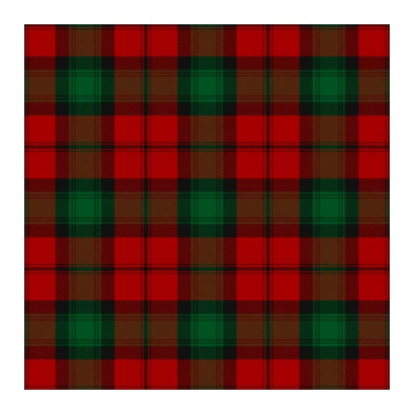


Textures & Mapping
An image mapped to a surface
Substitutes for geometric detail
$f:M→ℝ^{n}$
M is the manifold
$ℝ^{n}$ is the data
COMP 5812M: Foundations of Modelling & Rendering

Slide 4
So . . .
Any property we wish to store on a surface
We convert what we want to store to an image
Then use texture coordinates to access
COMP 5812M: Foundations of Modelling & Rendering

Slide 5
Adding Textures
Given texture coords for the pixel we can interpolate texels.
Start with a point p
Convert to surface parameters (s,t)
Convert to texel indices (i,j)
Retrieve texel colour
COMP 5812M: Foundations of Modelling & Rendering

Slide 6
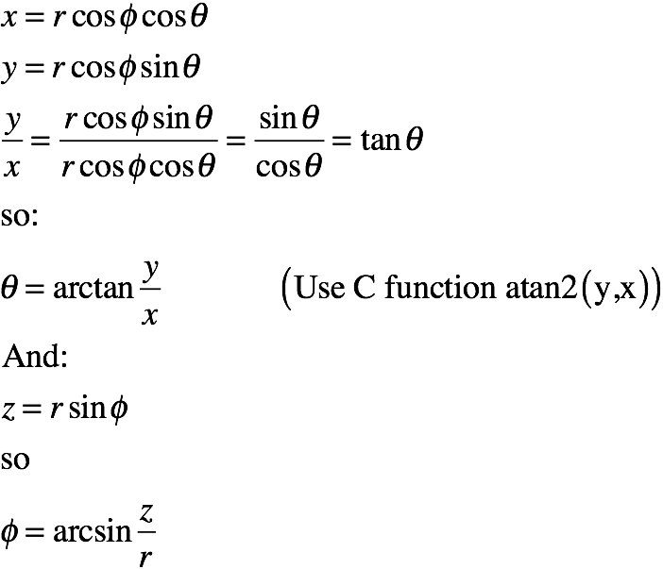
Analytic Solution: Spherical coordinates
Given x,y,z on a sphere
Find (θ,φ)
(lat., long.)
Then (i,j)
texture indices

Slide 7
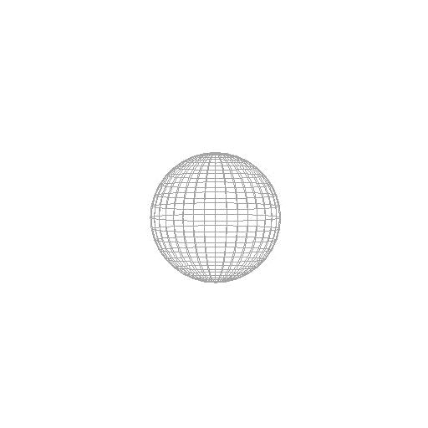
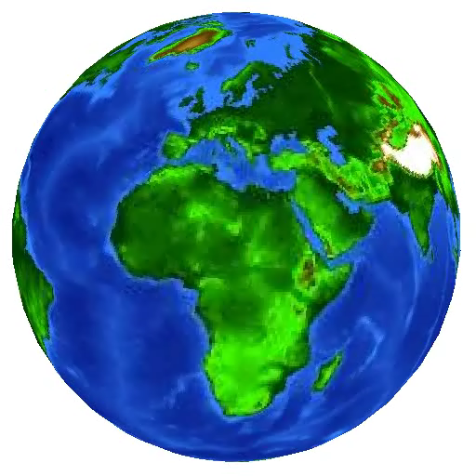
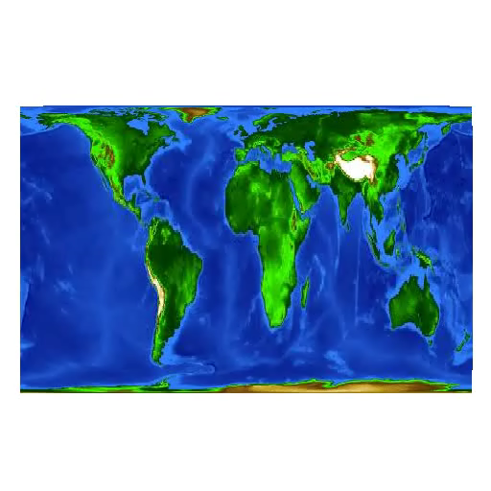
Textured Sphere with cylindrical projection

Slide 8
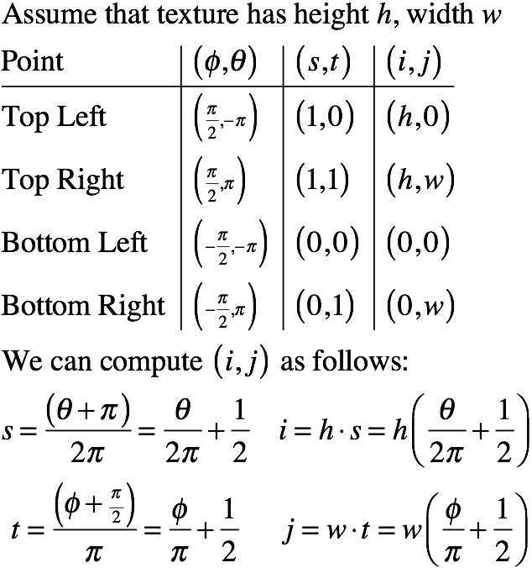
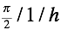
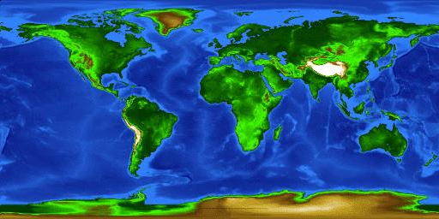
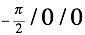
Texture Coordinates

Slide 9

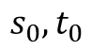
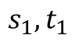
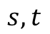
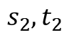
Practical Solution
$$s_{1},t_{1}$$
$$s,t$$
Give each vertex texture coordinates s,t
Use barycentric interpolation on triangles
Look up the resulting s,t in the image
As (row, col) coordinates
But the coordinates are almost never integers
So we will need interpolation
$$s_{0},t_{0}$$
$$s_{2},t_{2}$$

Slide 10
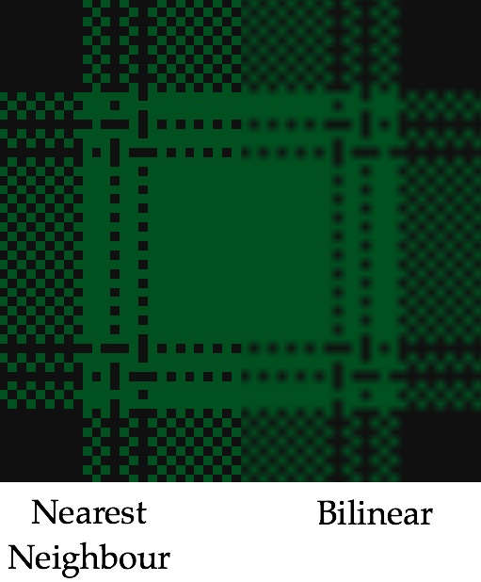


Texture Interpolation

Slide 11
Bilinear Interpolation
Interpolates on a quadrilateral
Iterates linear interpolation twice
Linear along the edges
Commonly used for texture interpolation

Slide 12
Development

Slide 13
Bilinear Surface
We get a small height field
Which is smooth / twisted
So we'll see more of these later

Slide 14
Code
RGBValue BilinearLookup(Image tex, float s, float t)
{ // BilinearLookup()
int i = s; // truncates s to get i
int j = t; // truncates t to get j
float sParm = s - i; // compute s for interpolation
float tParm = t - j; // compute t for interpolation
// grab four nearest texel colours
RGBValue colour00 = tex[i][j];
RGBValue colour01 = tex[i][j+1];
RGBValue colour10 = tex[i+1][j];
RGBValue colour11 = tex[i+1][j+1];
// compute colours on edges
RGBValue colour0 = colour00 + tParm * (colour01 - colour00);
RGBValue colour1 = colour10 + tParm * (colour11 - colour10);
// compute colour for interpolated texel
return colour1 + sParm * (colour1 - colour0);
} // BilinearLookup()

Slide 15
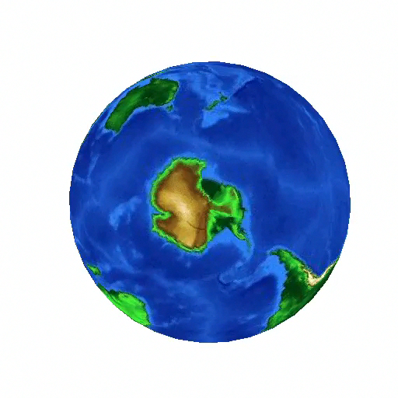
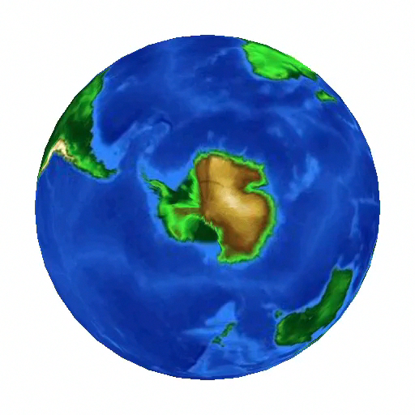
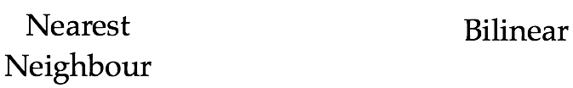
Bilinear Interpolation

Slide 16
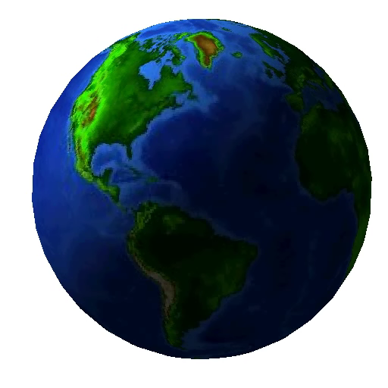

Replace vs. Modulate
GL_REPLACE
GL_MODULATE

Slide 17
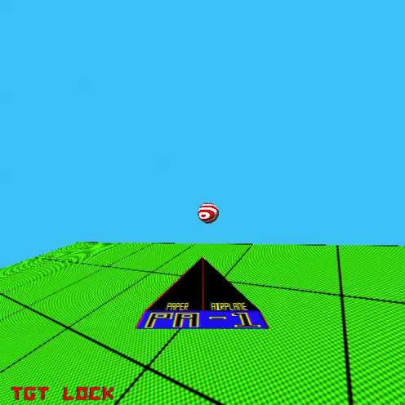
But . . .

Slide 18
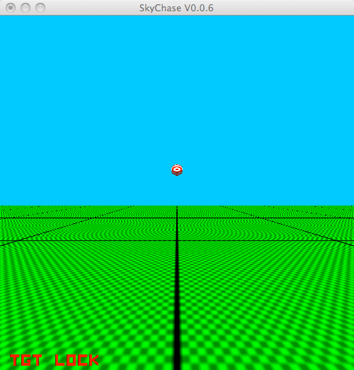
What Is Happening?
Perspective increases background frequency
No longer band-limited
Result: Moire patterns / aliasing
COMP 5812M: Foundations of Modelling & Rendering

Slide 19
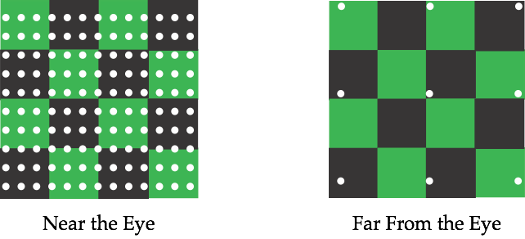
Point Sampling
Point sampling is best if it's dense
Perspective causes frequency to decrease
COMP 5812M: Foundations of Modelling & Rendering

Slide 20
Correct Solution
Integrate the light over patches
But this wastes samples on background

Slide 21
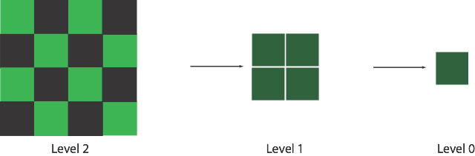
Approximation
Compute patches at half resolution
Repeat recursively
Mipmaps = multum in parvum maps

Slide 22
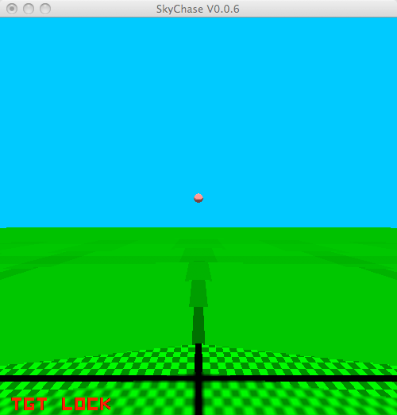
Improvement?
Choosing transition range is important
And you never quite get it right
So how to make it less abrupt?

Slide 23
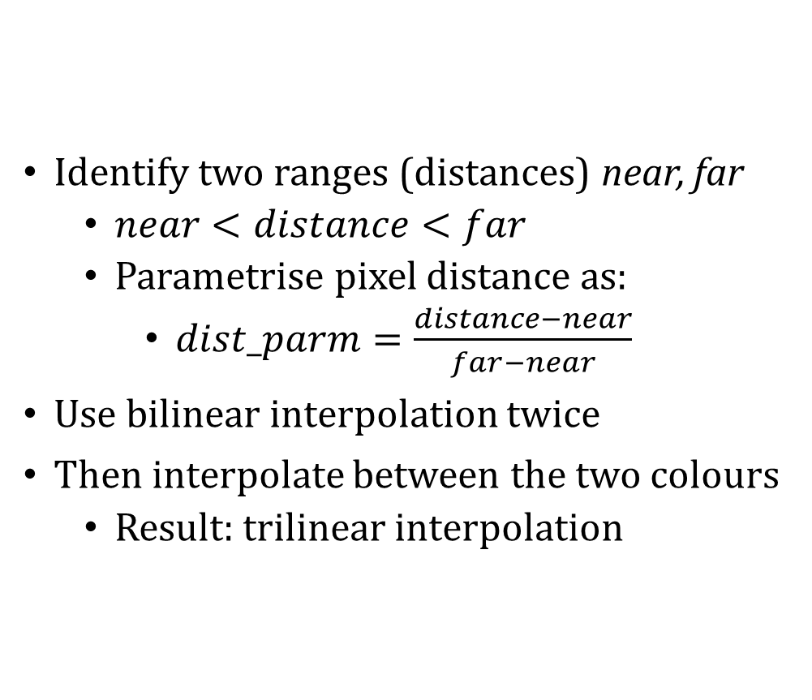
Trilinear Mipmapping
Identify two ranges (distances) near, far
$near<distance<far$
Parametrise pixel distance as:
$dist_parm=\frac{distance−near}{far−near}$
Use bilinear interpolation twice
Then interpolate between the two colours
Result: trilinear interpolation
COMP 5812M: Foundations of Modelling & Rendering

Slide 24
Trilinear Interpolation
Same idea as before, but repeated three times
Development is similar

Slide 25
Trilinear Equation

Slide 26
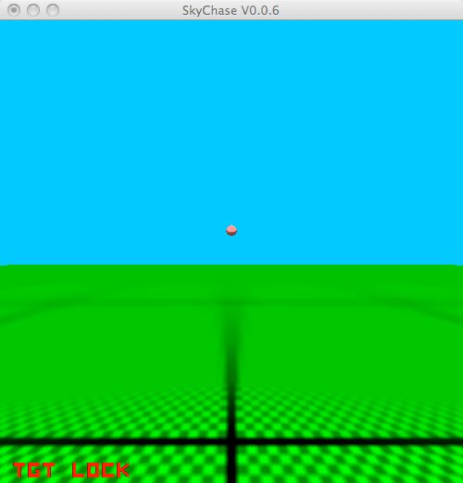
Trilinear Mipmapping
COMP 5812M: Foundations of Modelling & Rendering

Slide 27
Comparison

Slide 28

More generally
Mipmapping is a special case
We need a more general solution
But scaling up & scaling down are different
And this requires some image processing
COMP 5812M: Foundations of Modelling & Rendering

Slide 29
Example of Mappable Properties
Normal vectors
Colours
Material properties
BSSDFs
Surface deformations
Random seeds (use Nearest Neighbour)
Coefficients for calculations
COMP 5812M: Foundations of Modelling & Rendering

Slide 30
In the Phong Model
Diffuse reflection constant
Specular reflection coefficient
Diffuse, specular, ambient, emissive colours
Specular exponent
Whether or not in a shadow
Extra parameters for lighting equations
All of these can be made (u,v)-dependent
COMP 5812M: Foundations of Modelling & Rendering

Slide 31
Environment Maps

Slide 32
Irradiance Mapping
Diffuse surfaces are a different summation
So precompute the lighting on them
Approximates room lighting
Apply to multiple objects

Slide 33
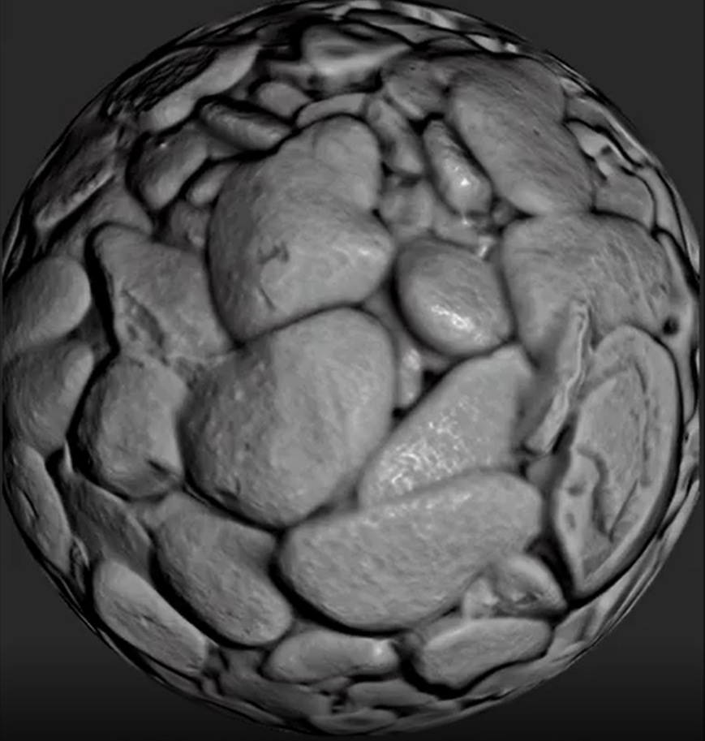
Bump Mapping
Models small changes in normal vectors
Simulates shadows from surface roughness
Stores per-pixel normal vectors
i) convert (x,y,z) to (r,g,b)
ii) normal perturbation stored as (r,g)
iii) height field stored as (r)

Slide 34
Volumetric Contours
Why not 3 coordinates?
Specify position in space
Use that to look up texture
Result: marble/wood/cheese
But volumetric textures are expensive

Slide 35
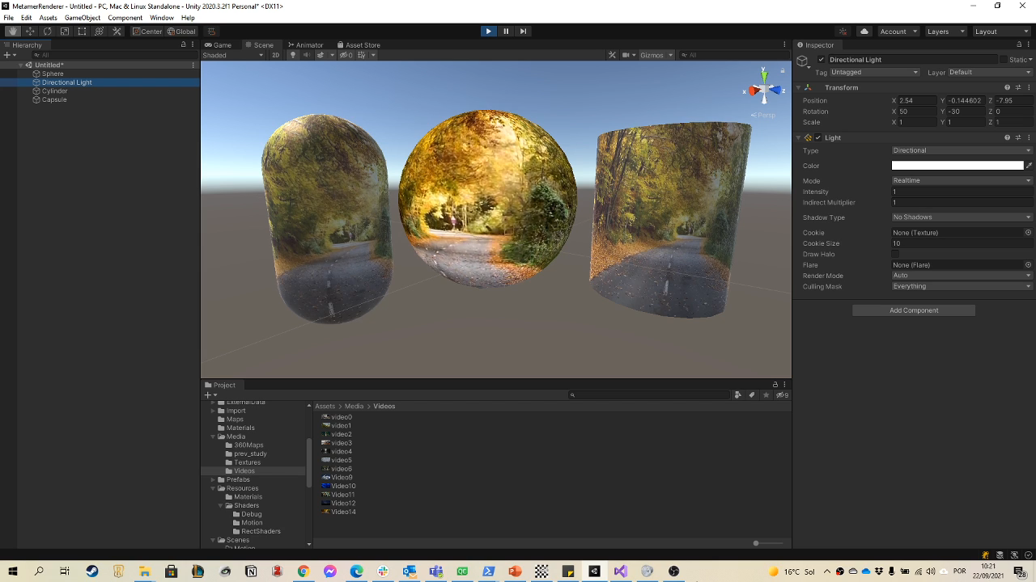
Video Textures
Store each frame as a slice in 3D
Store (u,v) coordinates for the screen
Set w = t based on the time you render
Result – video plays back on surface

Slide 36
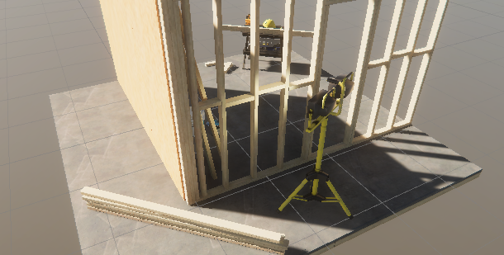
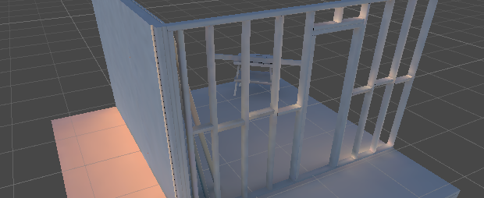
Light Maps
Precompute lighting from each light source
Store in separate textures
Compute final lighting as sum of active lights
Ignores characters in the scene
But massively speeds up scenery rendering
Leads to shadow maps (next term)

Slide 37
Projective Lighting
Light coming through a translucent surface
Store the light colour in a texture map
COMP 5812M: Foundations of Modelling & Rendering

Slide 38
How do you design Textures?
Pictures (e.g. environment map)
Acquired (scanning devices)
Artist-designed (painted on)
Spherical projection
Texture parametrization / deformation
Texture synthesis
COMP 5812M: Foundations of Modelling & Rendering

Slide 39
Creating Textures from attributes
Given a mesh M with
Vertex positions P
Texture coordinates U
Attribute values A
Render M in 2D
Using U as vertex positions, not P
And the texture will hold the attribute

Slide 40
Artist Designed
Painted onto a model, uv coords set by hand
Othman Ahmad - screenshot CC BY-SA 3.0

Slide 41
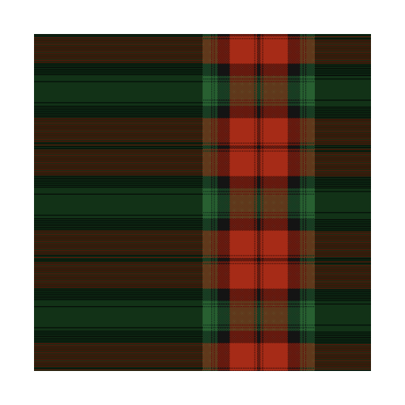
Texture Boundaries
What do we do at the edge of the texture?
We know that we can clamp or repeat
Repeating works for a torus or flat sheet

Slide 42
Texture Seams
Most surfaces are genus 0
A torus is genus 1
Which means we can’t just use repeat
And we end up with seams in the textures
Or map (project) each surface to a sphere
Which we can cover with a single texture

Slide 43
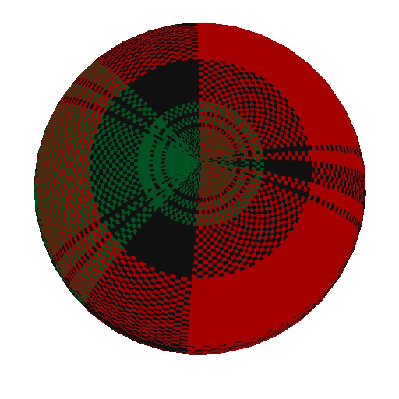
Texture Distortion
Texture details are unevenly distributed
How do we use texels efficiently?

Slide 44
Texture Synthesis
Write code to create texture
Not good for humans
Pretty good for some tasks
Fourier Synthesis
Perlin Noise
Reaction-Diffusion
Data-Driven
COMP 5812M: Foundations of Modelling & Rendering

Slide 45
Fourier Synthesis
Define a sum of sines & cosines
Use that for a mottled appearance

Slide 46
Perlin Noise
Randomise some points
Use spline curves / surfaces to interpolate
Use this to generate an image

Slide 47
Reaction-Diffusion
Models pigment production in skin
Useful for animal coats, &c.
Essentially a small numerical simulation

Slide 48
Data-Driven Generation
Use a small travelling window
Pick a matching window in sample image
Copy next pixel based on that

Slide 49
Image (Re-)Synthesis
Huge overlap with image processing

Slide 50
Summary
Texture mapping is an indirection
Allows mapping any property to surface
Therefore used as a lookup mechanism
Either in an array or in a function
Many, many variations
Geometry underneath drives a lot of it
COMP 5812M: Foundations of Modelling & Rendering

